Slide 1
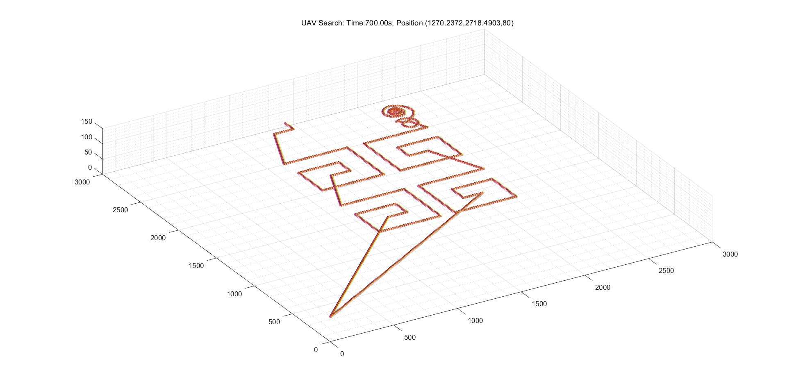
6
5
3
4
3s
3s
2s
3s
s
3s
2
1

